Slide 1
TABA Assignment Report Client – Kia Seltos Source – User Reviews of Kia Seltos, Jeep Compass, MG Hector
Team Members:
Balaji[], Harini[], Jannavi[], Pavan[], Ruma Mukherjee[11920073]

Slide 2
Data Collection via Web Scraping
Data used:
Sites: carwale.com, carsdekho.com
Total dataset: 261[Kia Seltos], 228[Jeep Compass], MG Hector[304]
Files attached:
Car-rating-Kia_total.csv,
Car-rating-Jeep_total.csv
Car-rating-MG_total.csv
Review parameters:
'Review-Text’,
'Review-Date’,
'Star-Rating’
Technology: Selenium
Car-Scrape-carwale-xxx.ipynb
*All data available till date in carwale.com has been augmented with the negative rated data from carsdekho.com to get a better representation of all kinds(positive/negative) of reviews

Slide 3
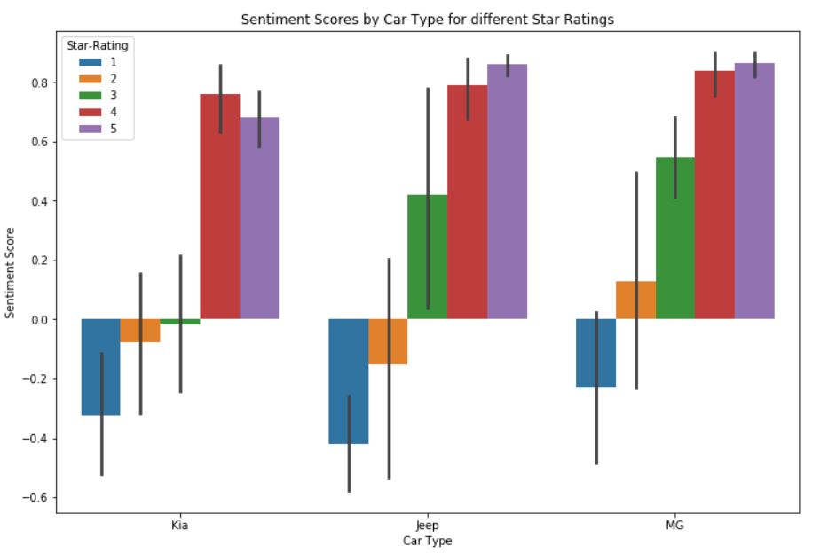
Customer View of Kia Seltos – a comparison
The intensity of positive emotions of Jeep Compass and MG Hector are almost similar and somewhat better than Kia Seltos
The negative emotions, however, are more intense for Jeep Compass and quite mild for MG Hector
Kia is very often compared with Creta,Hyundai, Tata,Hyundai. Superior quality of Creta as compared to Kia Seltos is a concern in the reviews.

Slide 4
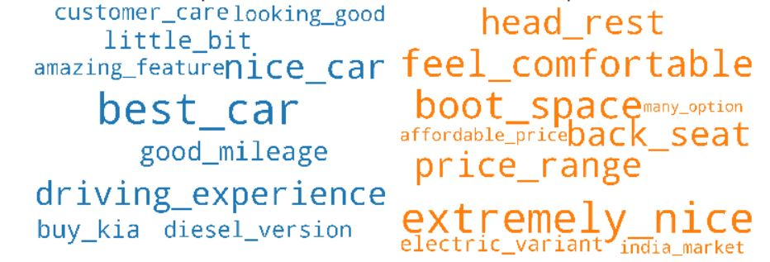
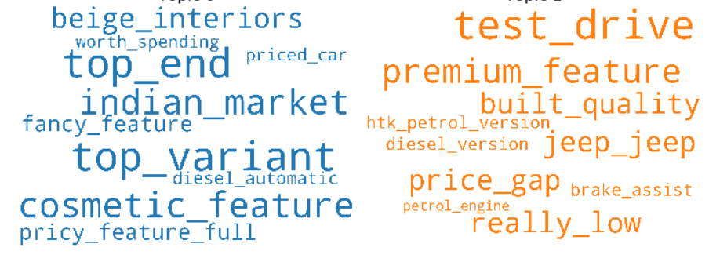
Strengths vs Weaknesses – Kia Seltos
Holistic Experience: great look, good driving experience, customer care, comfort, price, good mileage
Features: back seats, head rests, boot space,
Holistic Experience: Low design and built quality, cosmetic features, price vs premium features, fitment to India market, test drive
Features: Lacks of sun roof, beige interiors, brake assist

Slide 5
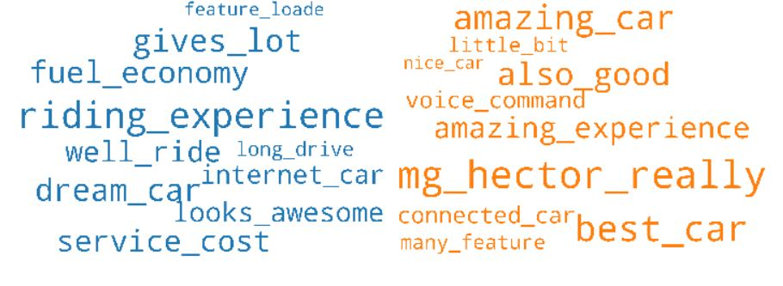
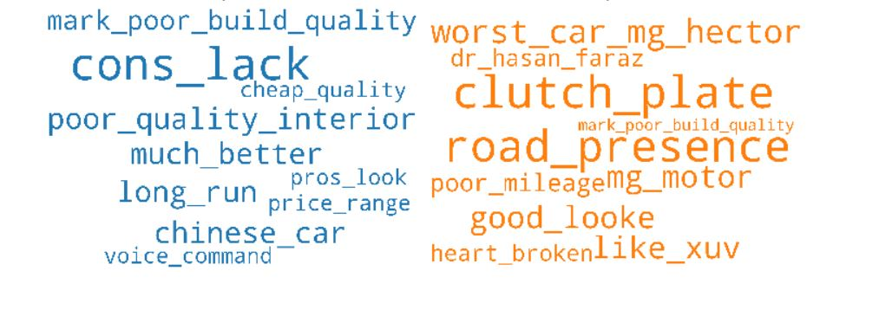
Strengths and Weaknesses of Competitor - MG Hector
* Left and Right sides are word cloud representations of the Strengths and Weaknesses respectively of MG Hector

Slide 6
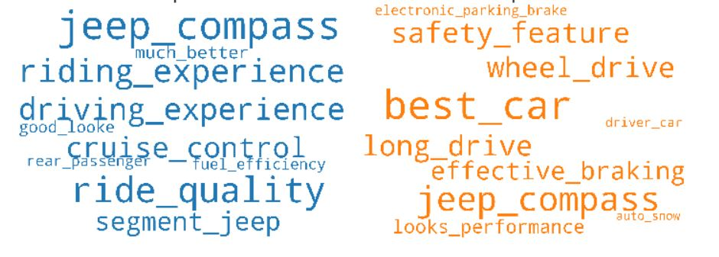
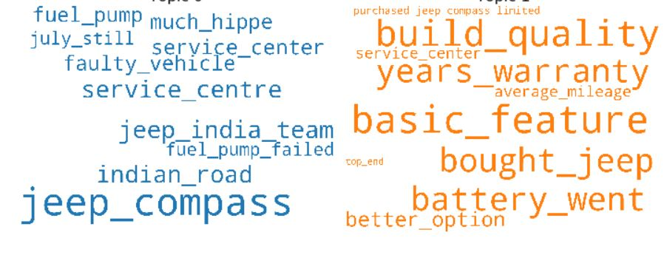
Strengths and Weaknesses of Competitor - Jeep Compass
* Left and Right sides are word cloud representations of the Strengths and Weaknesses respectively of Jeep Compass

Slide 7
Emotional Connect with Customers
Good look, good driving experience, comfort, price, good mileage, premium features, Quality, safety features
Customer care, Value for money and Fitment to Indian roads
Comparison of features as provided by the competitors in the same segment
Expectations set vs Actual feature qualities
customer care,

Slide 8
Positioning and Promotions
Promotions:
Focus on comfortable features – back seats, head rest, boot space etc
Good looks
Good driving experience
Customer care
Improvement Areas:
Premium features like sun roof etc
Alternative to beige colored interiors
Of particular significance from market development point of view are phrases like 'india_market', 'electric_variant' which come out in the textual analysis we have done. These would be the actionable insights that require further marketing analysis.
customer care,

Slide 9
Thank You!

